Slide 1
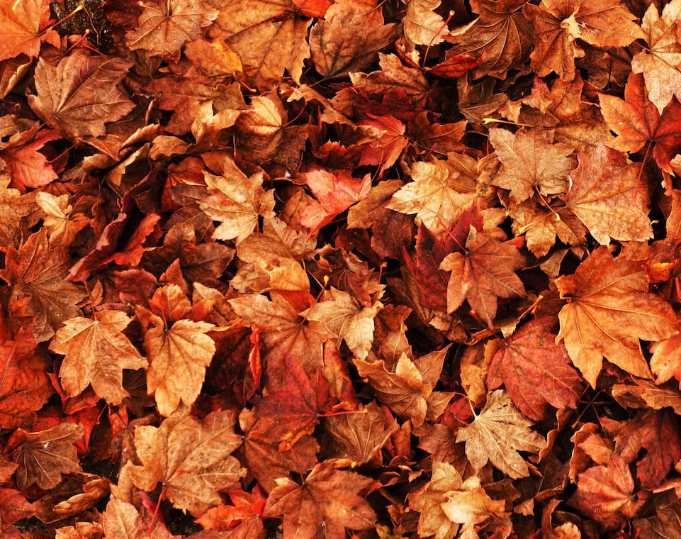
UNIT 8
Lesson 1

Slide 2
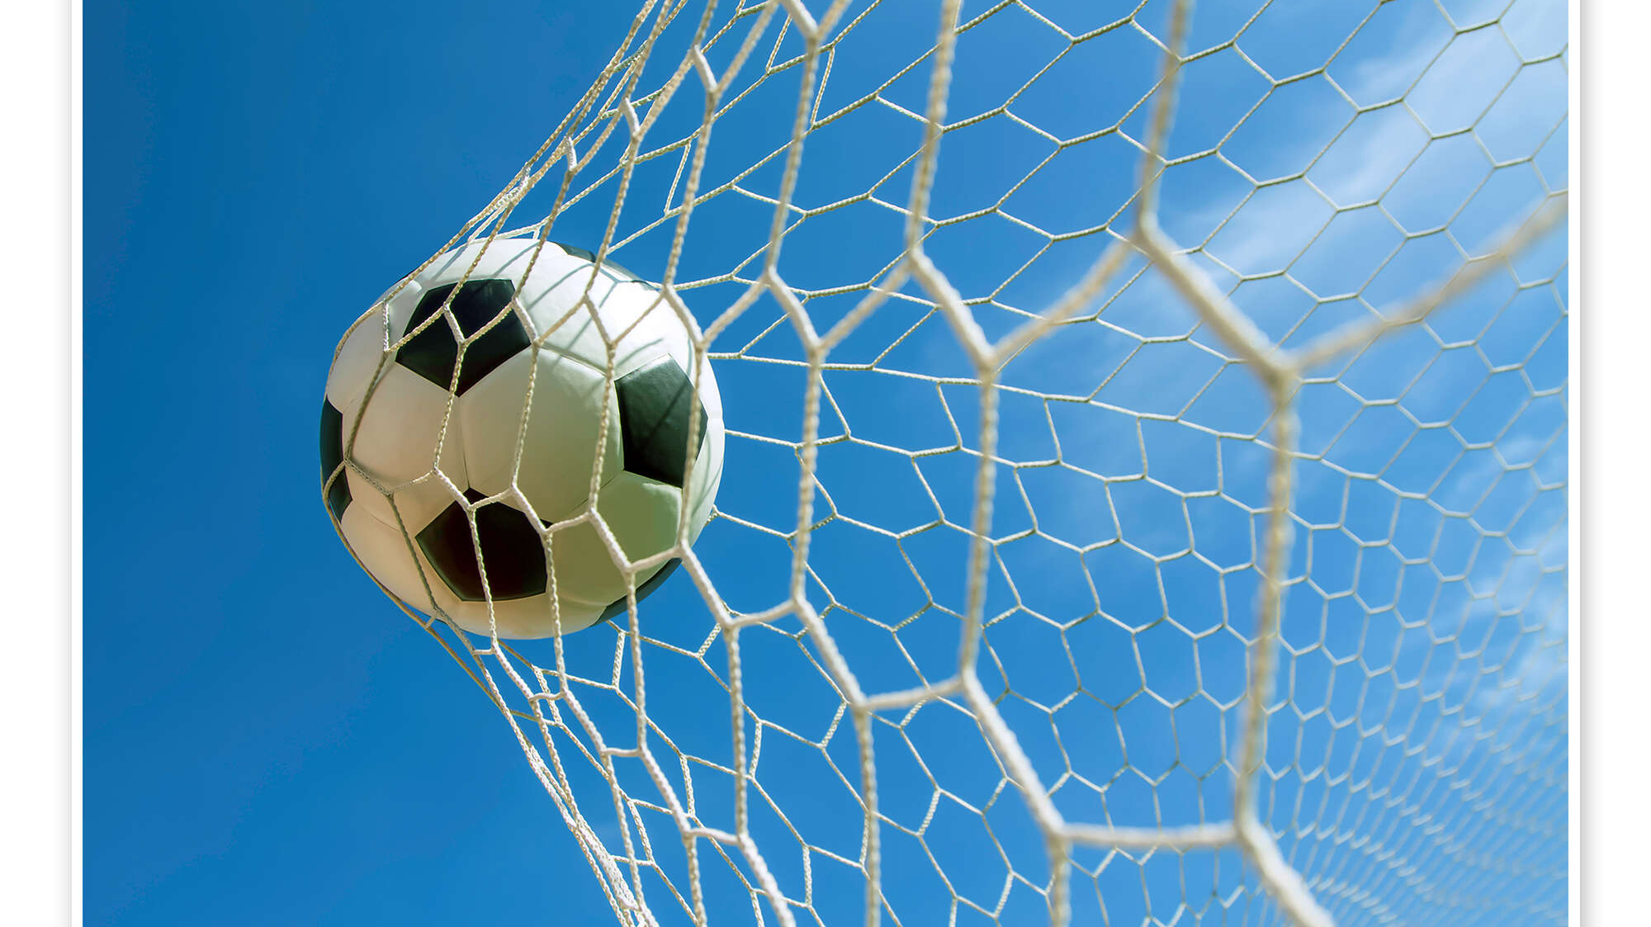
UNIT GOAL
ひんとくいずをつくりましょう！

Slide 3
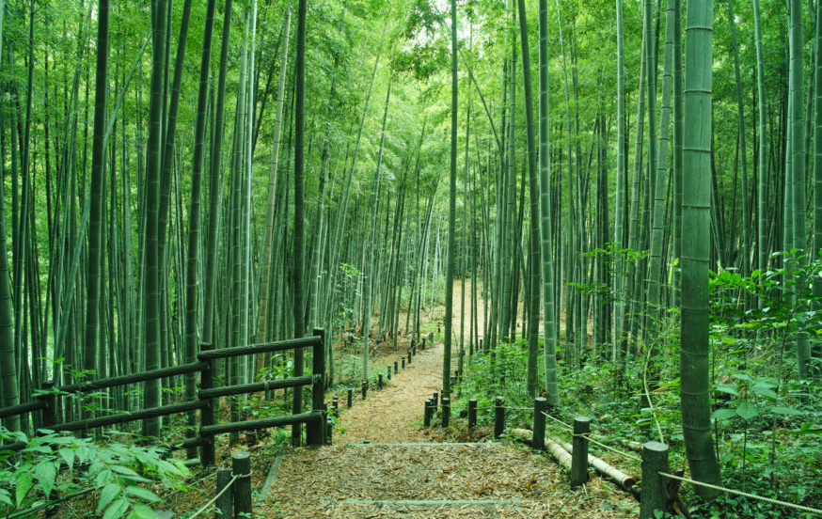
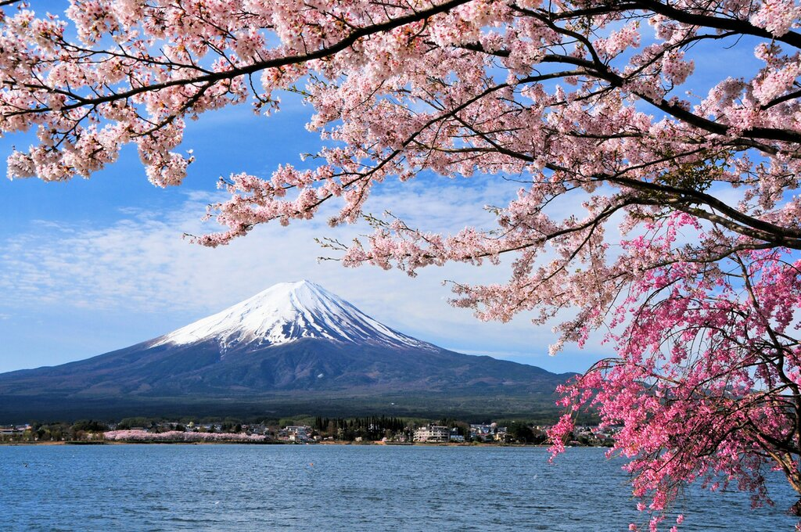
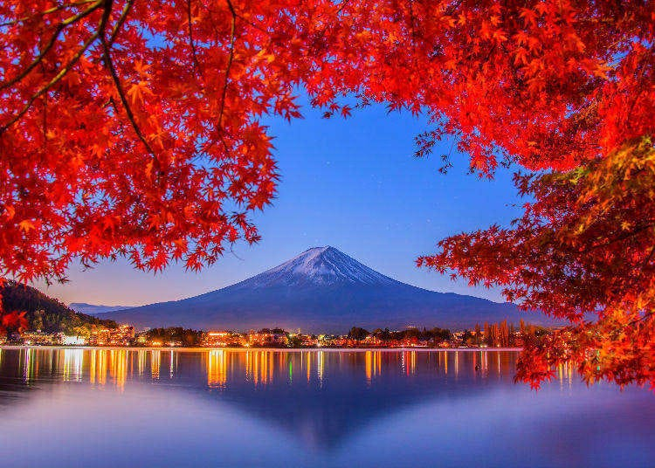
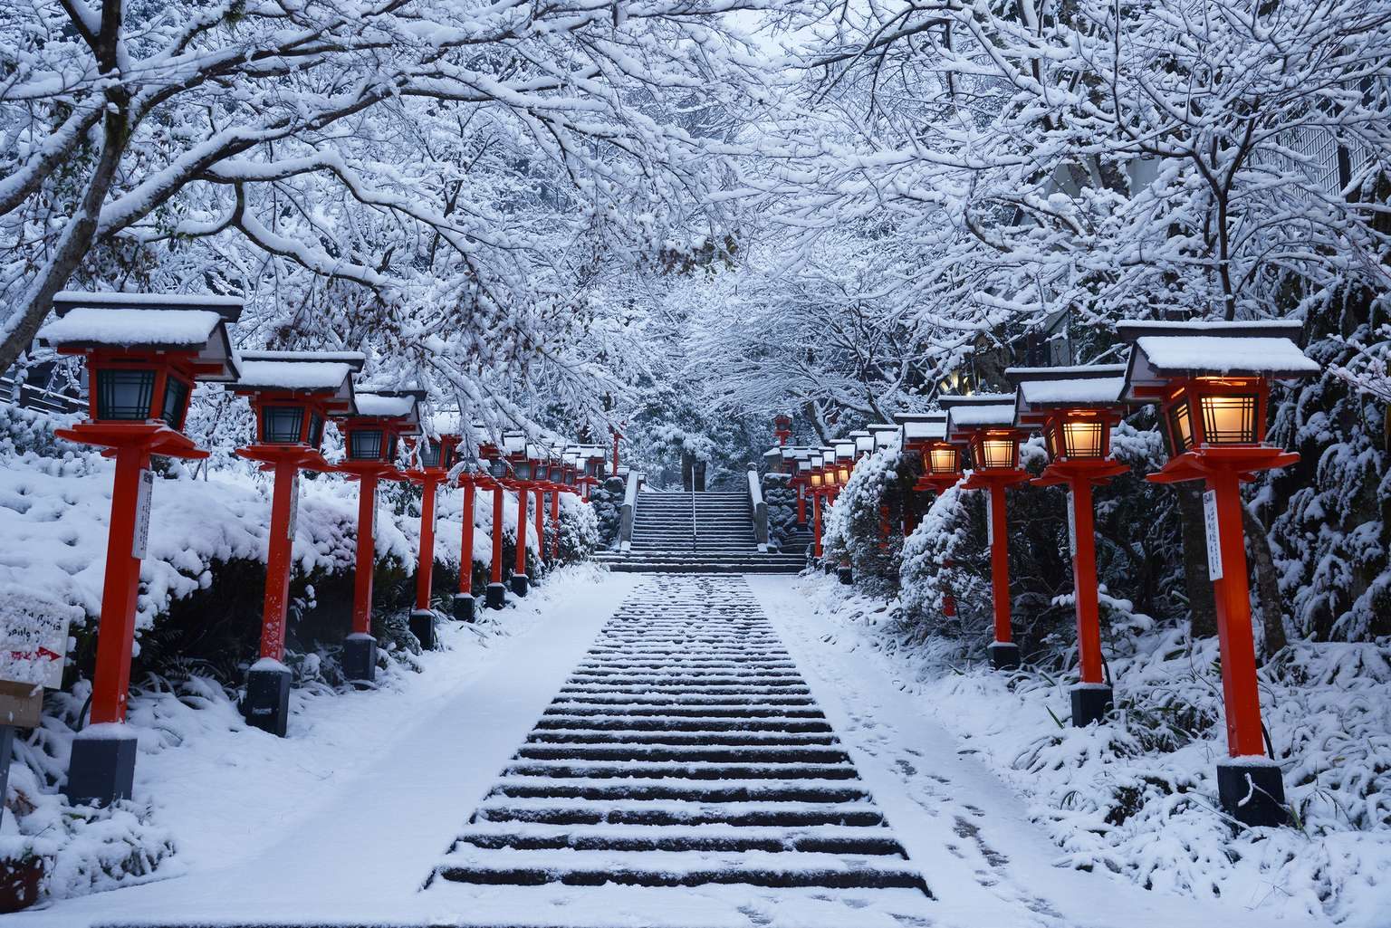


きせつ
SEASON

Slide 4
SPRING
きせつ?

Slide 5
SUMMER
きせつ?

Slide 6
FALL AUTUMN
きせつ?

Slide 7
WINTER
きせつ?

Slide 10
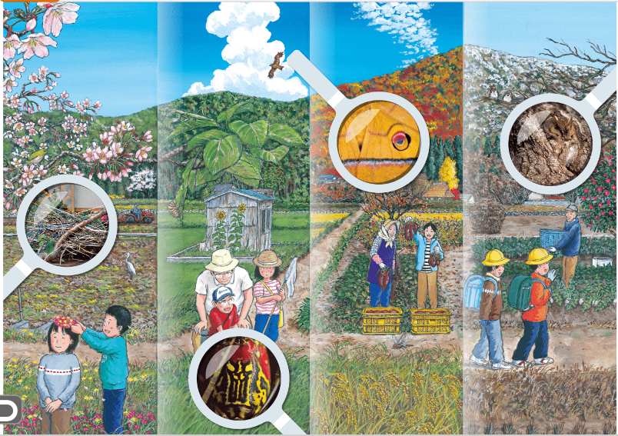
SPRING
SUMMER
AUTUMN
WINTER

Slide 11
Open your textbook on page 30

Slide 12
1.
WHAT’S THIS?

Slide 13
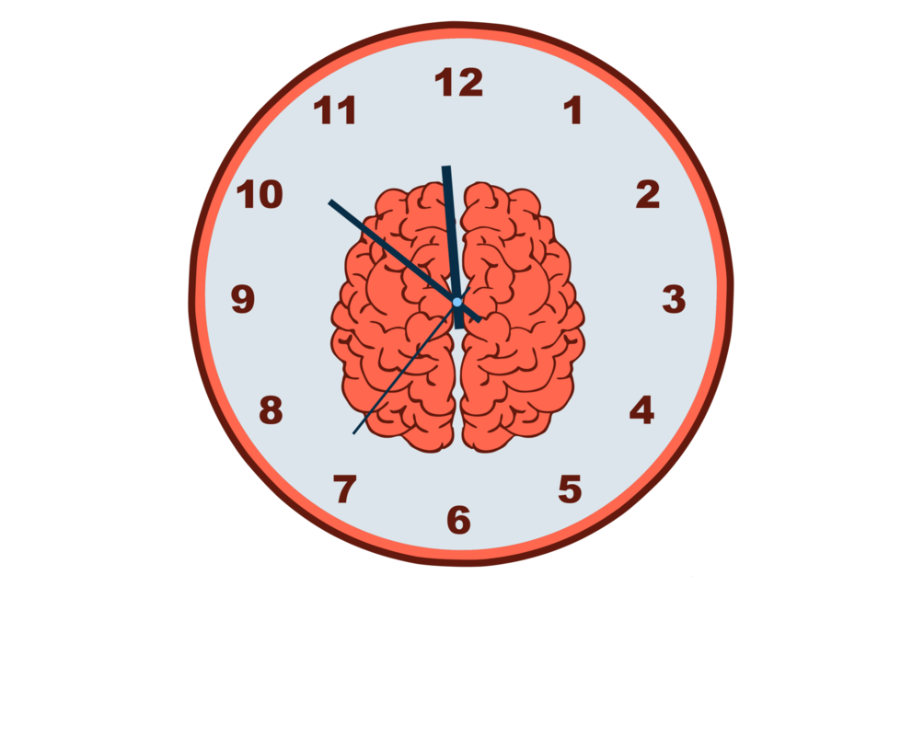
2 minutes thinking time
1.

Slide 14
2.
WHAT’S THIS?

Slide 15
2 minutes thinking time
2.

Slide 16
3.
WHAT’S THIS?

Slide 17
2 minutes thinking time
3.

Slide 18
4.
WHAT’S THIS?

Slide 19
2 minutes thinking time
4.

Slide 20

LET’S LISTEN

Slide 21

WHAT DID YOU HEAR?

Slide 22
これわなんですか？
What's
this?

Slide 23
これわなんですか？
What's
this?

Slide 24
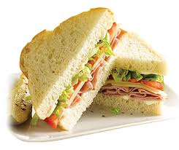
これわなんですか？
What's
this?
It's a
______

Slide 25

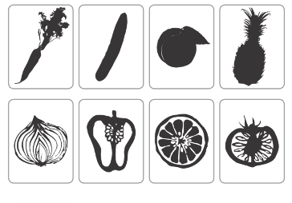
It’s a________.

Slide 26
QUIZ TIME

Slide 27
What’s this?

Slide 28

What’s this?

Slide 29
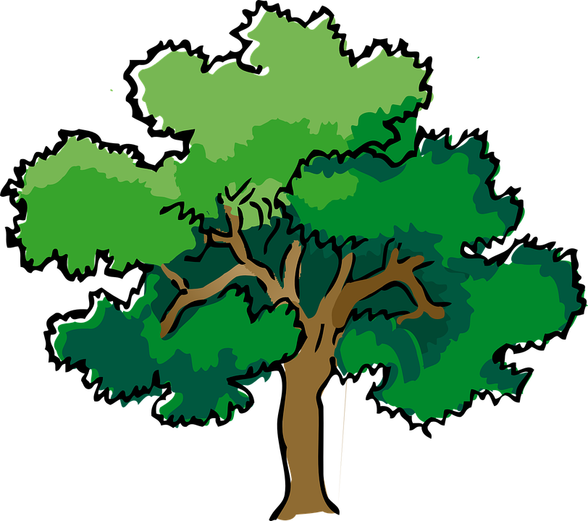
It’s a tree!

Slide 30

What’s this?

Slide 31
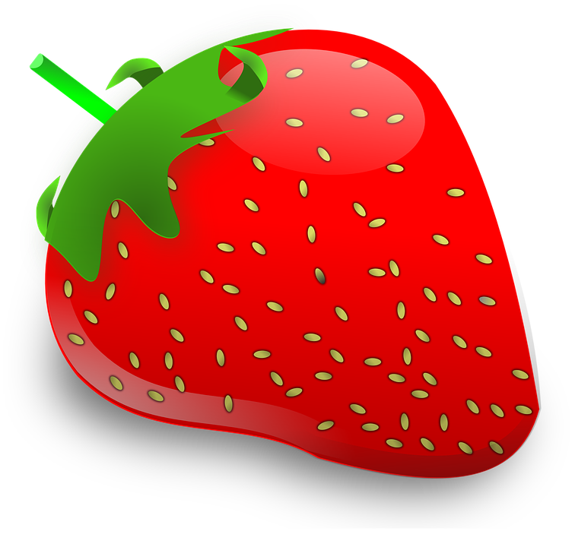
It’s a strawberry!

Slide 32
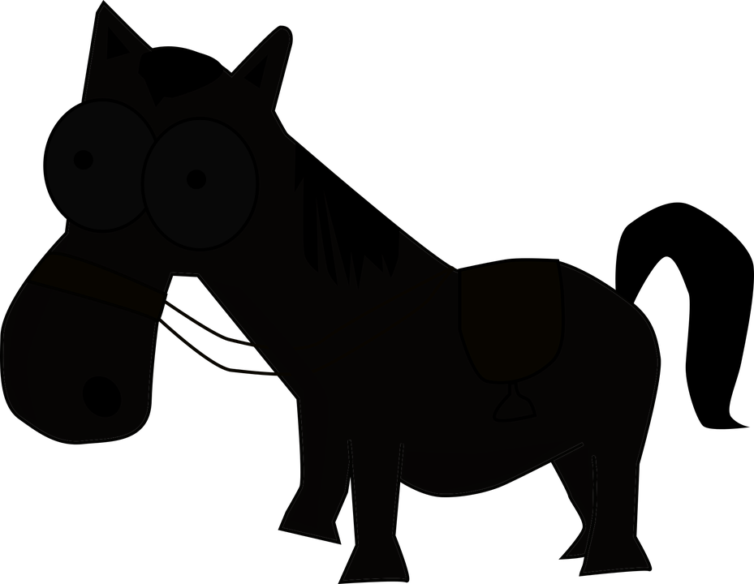
What’s this?

Slide 33
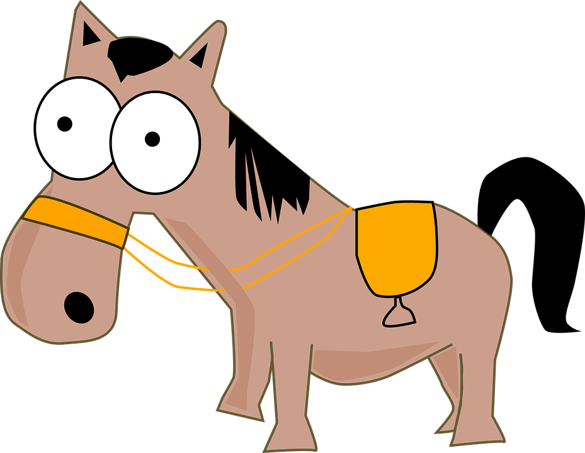
It’s a horse!

Slide 34

What’s this?
This Photo by Unknown Author is licensed under CC BY-NC

Slide 35

It’s an owl!
This Photo by Unknown Author is licensed under CC BY-NC

Slide 36
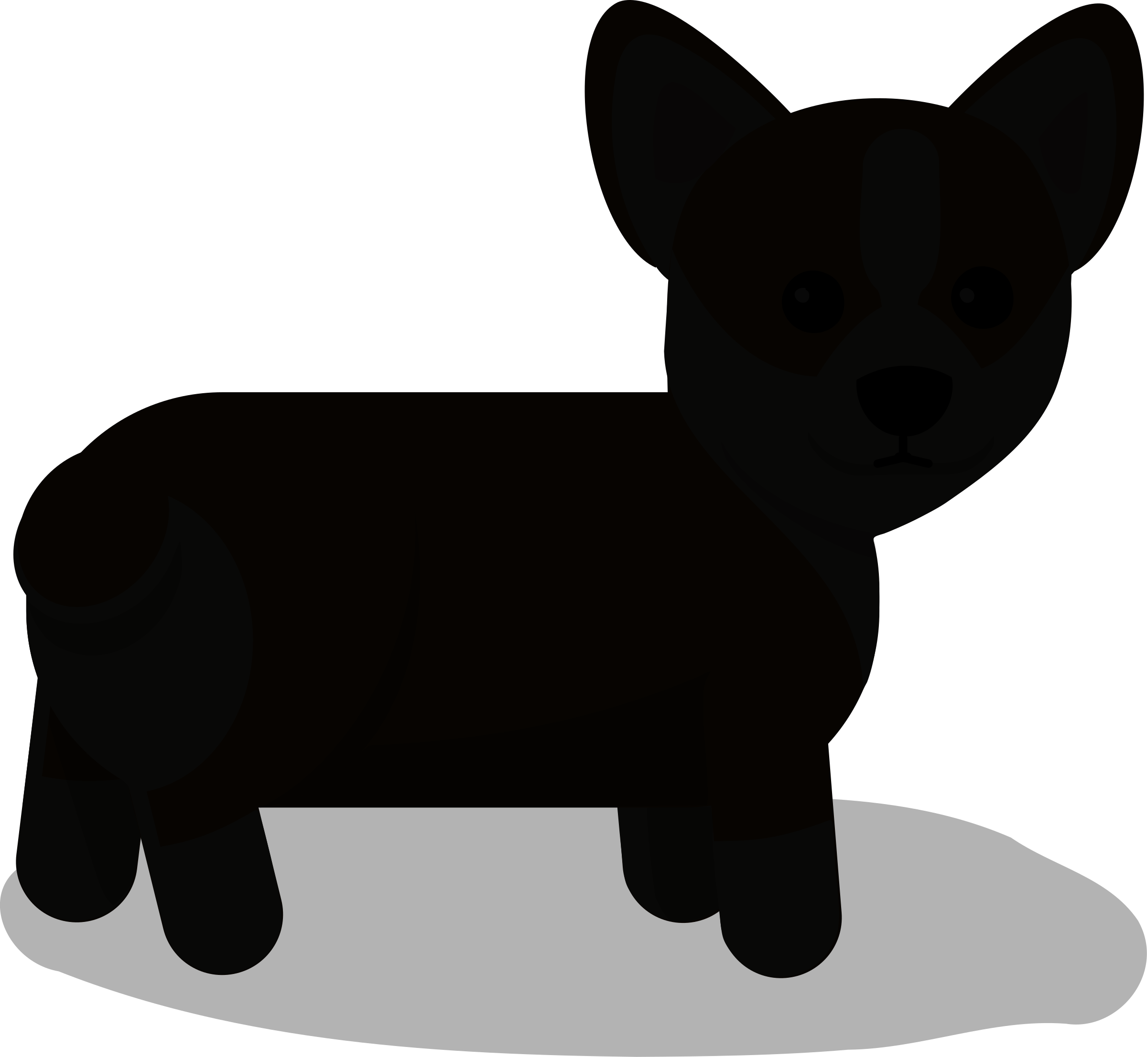
What’s this?

Slide 37
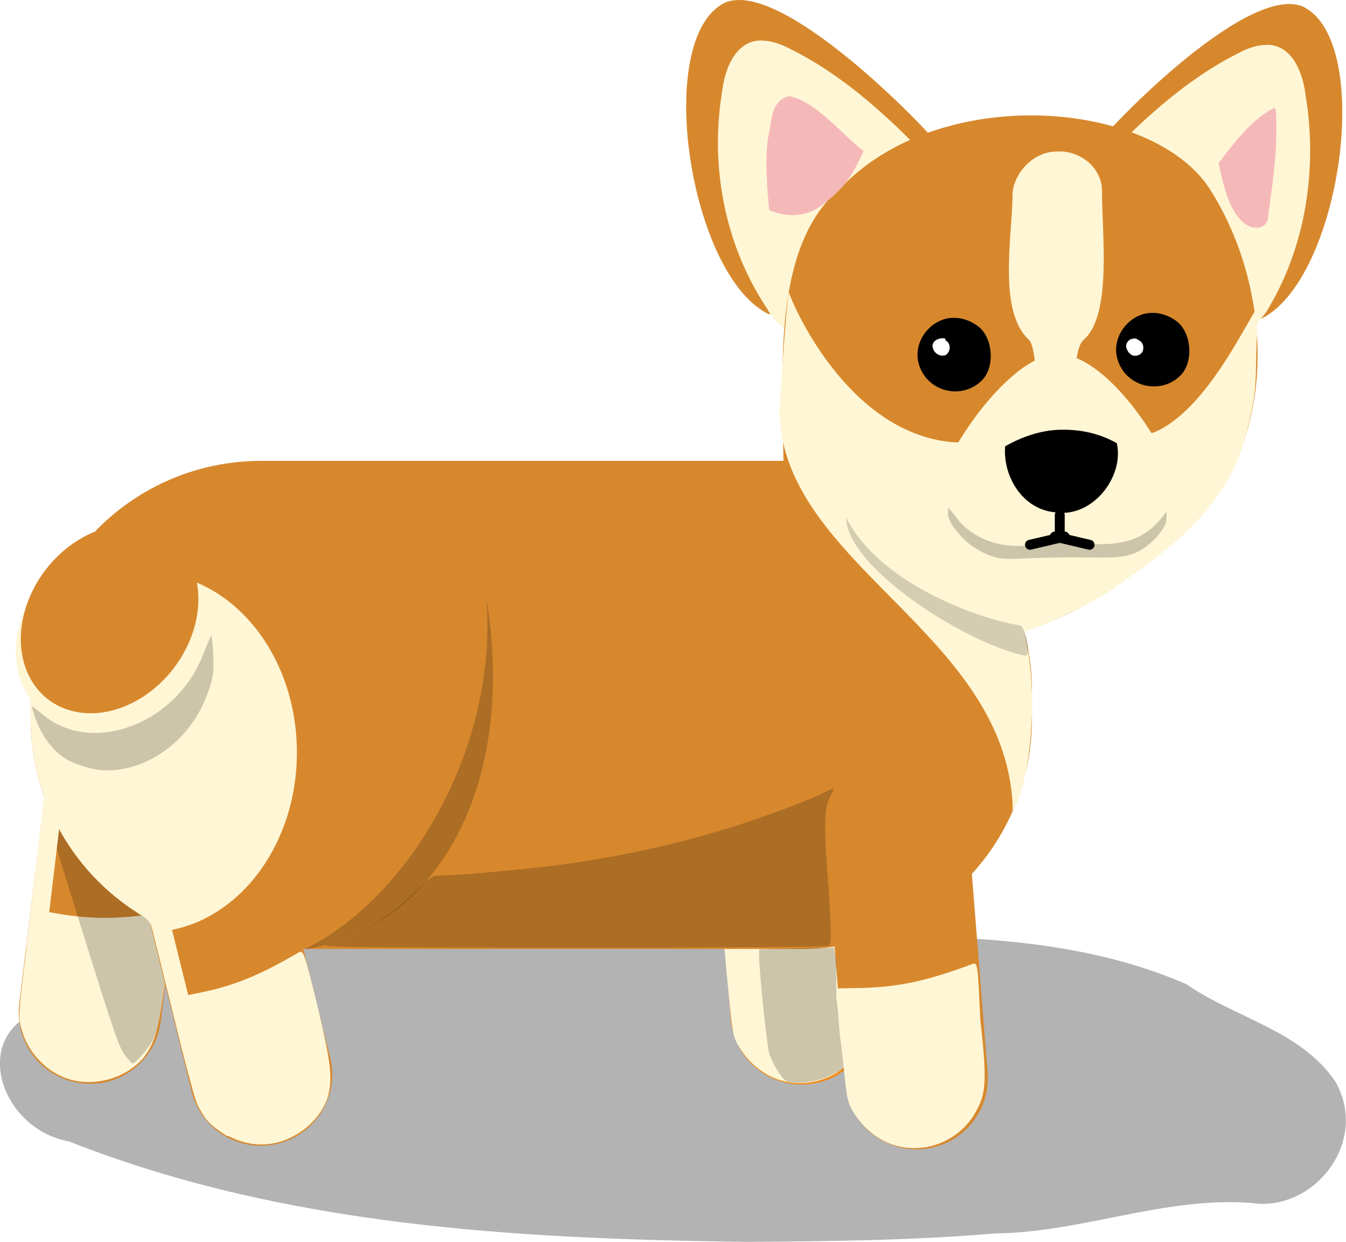
It’s a dog!

Slide 38



Slide 39
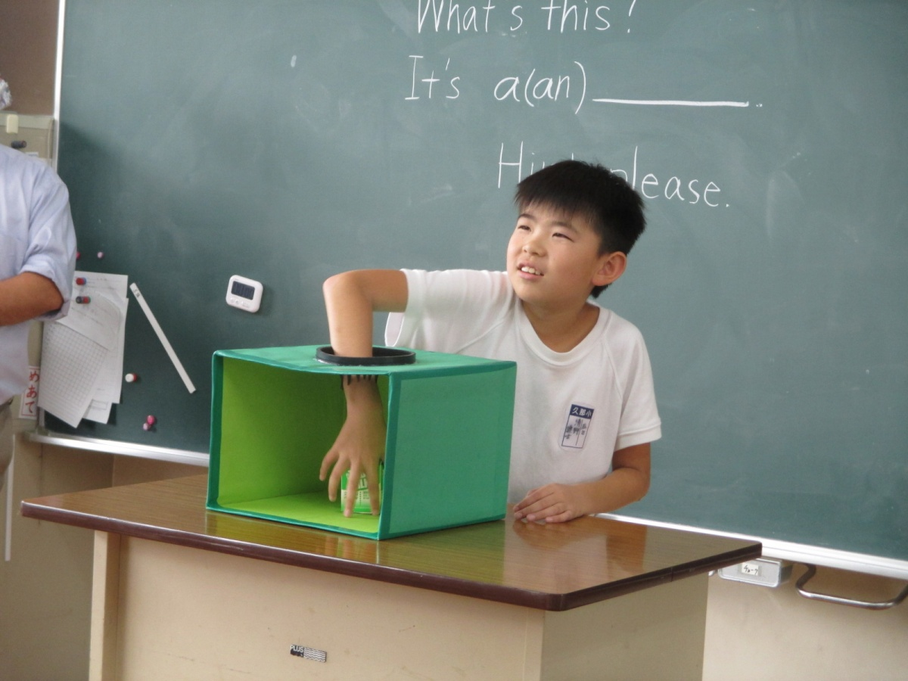
BLACK BOX
Random number selector 1-30 - Spin the wheel
Have the student touch the object. Have the other students ask "What's this?" If the student doesn't get it right away, you can have the other students can give hints related to color, shapes, size, etc. When the student finally gets it, you can have them say "I got it! It's a/an 〜."
You could also have the guessing student ask "Is it a/an〜?"

Slide 40
What’s this?
これ は なん です か？
It’s a _____.
Hint please.
これは____です。
ヒントをください。

Slide 41
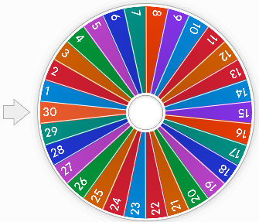
みんな: What’s this?
もし こたえ を しっている なら
: It’s a ________. (にほんごはだいじょうぶ)
もし こたえ を しらない なら
: Hint, please.
2 minutes
みんな: (Hint 1: category) It’s a________.
It's __________.
Animal(アニマル)どうぶつ
Food(フード) たべもの
Fruit (フルーツ) くだもの
Vegetable(ベジタブル) やさい
toy (トイ) おもちゃ
もし こたえ を しらない なら
: Hint, please.
みんな: (Hint 2: color) It’s ________.
もし こたえ を しらない なら
: Hint, please.
みんな: (Hint 3: shape/それにかかわるほかのことば) It’s ________.

Slide 42
Category
Animal(アニマル)どうぶつ
Food(フード) たべもの
Fruit (フルーツ) くだもの
Vegetable(ベジタブル) やさい
toy (トイ) おもちゃ
Hint 1:
It’s ______.

Slide 43
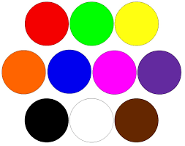
Hint 2: It’s ______.
color

Slide 44
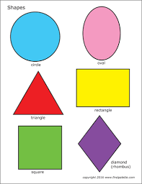
Hint 3: It’s _______.
それにかかわるほかのことば

